Slide 1

Exploring the Yelp Dataset – provided by and the intellectual property of Yelp
Group Members:
Carter Reid reidcc@Colorado..edu
Garrett Lubin galu7424@Colorado.edu
Maxwell Reynolds mare3521@Colorado.edu
Surya Jatavallabhula suja3865@Colorado.edu

Slide 2

Questions
Correlation between strength of economy and restaurant reviews?
Can we identify common pitfalls for certain restaurant categories?
Can we characterize the most important aspects of different restaurant categories?
Are “funny” reviews considered more or less helpful than “cool” reviews?

Slide 3

Data Used:
Yelp
Business.json – business id, name, geographic data, other classifiers
Review.json – review text, user and business id, useful, funny, cool, and stars awarded
Federal Reserve Bank of St. Louis
Phoenix, AZ monthly unemployment

Slide 4




Tools Used:

Slide 5
Data Preparation :
JSON -> SparkSQL -> Pandas
Word count analysis
Punctuation
Capitalization
Stop Words
Lemmatiztion

Slide 6
Methods:
Linear Regression
Correlation Coefficient
Phi Coefficient
Disjunctive Union of frequent words to identify unique attributes
Naïve Bayes theorem

Slide 7
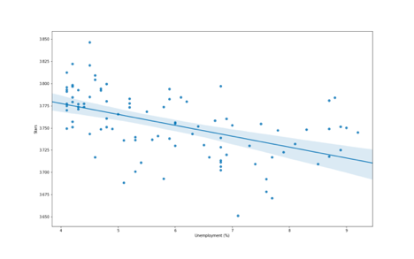
Insight:
Lower unemployment correlated with higher reviews

Slide 8


Application:
Choosing a time to open a restaurant

Slide 9
Insights:
Category-specific 1-star Reviews
Chinese
Italian
Japanese

Slide 10
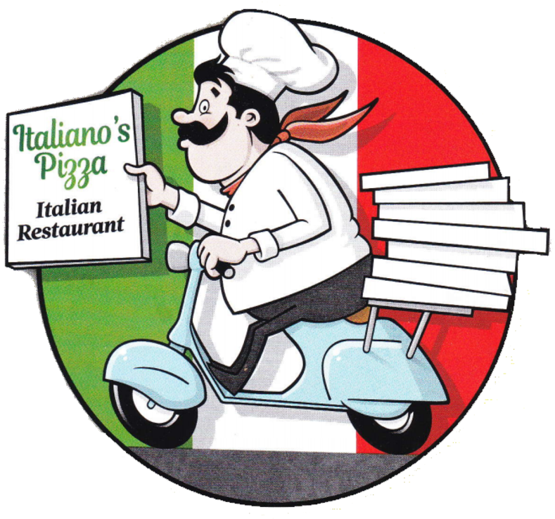
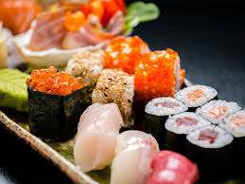
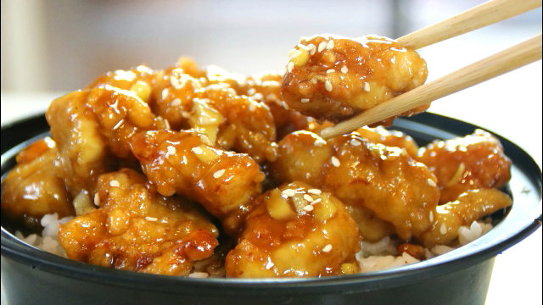


Applications:

Slide 11
Insights:
1-Star reviews: Negativity, bad service, time wasting, illness
2-Star reviews: Housing, automotive, pharmacy
3-Star reviews: Entertainment, Sports, Movies
4-Star reviews: Good food, fresh ingredients, Italian and Asian foods
5-Star reviews: Specific names, excellent customer service, positivity, staff, art, and education.

Slide 12
Application:
“You can dream, create, design and build the most wonderful place in the world… but it requires people to make the dream a reality.”
– Walt Disney
“The secret to my success is that we’ve gone to exceptional lengths to hire the best people in the world.” – Steve Jobs
“The Who is more important than the What.” – Ray Dalio

Slide 13
Insights:
It is better to be cool than funny, though being both is better.

Slide 14
Application:
A user trying to reach the broadest audience should attempt to engage readers with funny and cool language.

